Slide 1
Numerical examples
Performance analysis- Parallel and Distributed Systems

Slide 2
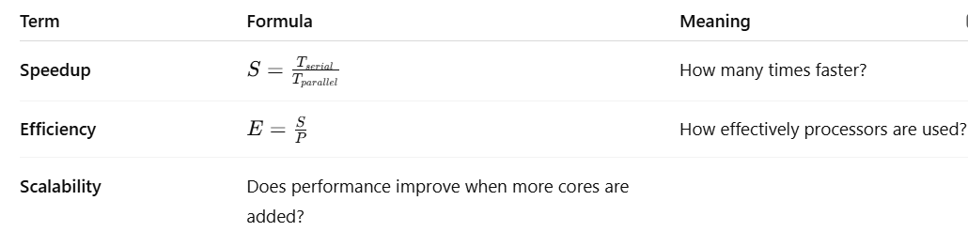
Foundation Metrics
High S, high E: algorithm scales well; overheads/serial fraction small.
High S, low E: good absolute speed but diminishing returns (likely overheads or load imbalance).
Low S even for large N: serial bottleneck dominates (increase parallel fraction or reduce sync/I/O).

Slide 3
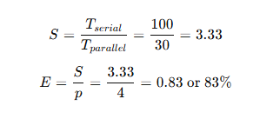
Example 1 — Basic Speedup and Efficiency
A sequential program takes 100 seconds to execute. When parallelized on 4 cores, the execution time becomes 30 seconds.
Find:
Speedup
Efficiency
Interpretation: The program runs 3.33× faster and uses 83% of the available parallel capacity efficiently.

Slide 4
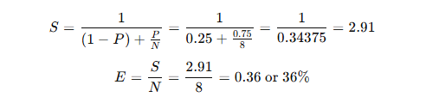
Example 2 — Amdahl’s Law Application
A program is 25% sequential and 75% parallelizable. Compute speedup on 8 processors.
Interpretation: Even with 8 processors, sequential bottlenecks limit total speedup to only 2.9×.

Slide 5
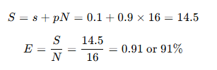
Example 3 — Gustafson’s Law (Scaled Problem Size)
If 10% of a task is sequential and 90% is parallelizable, find the speedup for 16 cores.
Interpretation: When workload scales with more cores, efficiency remains high — nearly linear scalability.

Slide 6
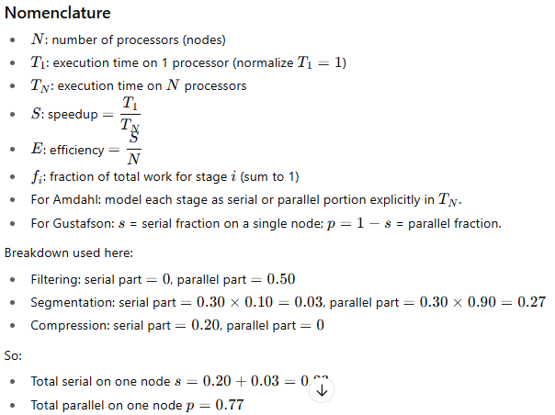
Example 4 — A parallel image processing pipeline runs on 20 worker nodes using a work-stealing scheduler. Each image tile passes through the following three stages:
Assume: The workload is perfectly balanced across all nodes (no idling). The workload scales linearly with problem size (i.e., more tiles keep all 20 nodes busy).
Using Amdahl’s Law, calculate the maximum overall speedup achievable on 20 nodes.
2. Using Gustafson’s Law, compute the projected speedup assuming the workload scales with problem size.
SOLUTION:
Parallel Image Pipeline — Speedup & Efficiency
Given (per image tile)
System: 20 worker nodes, work-stealing scheduler Assumptions: perfect load balance; linear scale with problem size; negligible scheduling overhead outside stated sync cost.
Stage | Fraction of total work | Parallelism characteristics
Filtering | 0.50 | perfectly parallelizable
Segmentation | 0.30 | 10% serial (sync), 90% parallelizable
Compression | 0.20 | fully serial (I/O ordering)

Slide 7
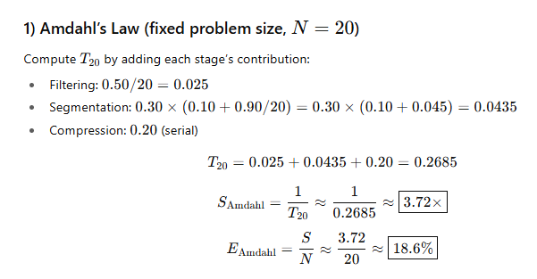
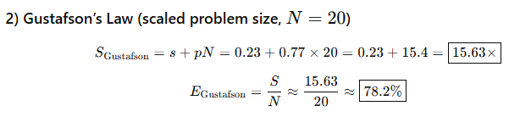
With a fixed workload, the 23% serial portion caps speedup at ~3.7× on 20 nodes.
With a scaled workload that keeps all nodes busy, projected speedup is ~15.6× with ~78% efficiency.

